Slide 1





Introduction to Robotic Process Automation
CUSTOMISED CAKE ORDERING BOT
220701231
Rudra S
Dr.N.Durai Murugan
Computer Science and Engineering

Slide 2
Abstract
This guide details the process of building a customized cake ordering bot using UiPath Studio. The bot collects customer inputs, such as cake size, flavor, and special requests, through an interactive form, validates the data, calculates the total price based on selections, and displays an order summary for
confirmation. Optional functionality
includes sending order details via email. The workflow concludes with a final
confirmation message, providing a seamless and automated solution for cake ordering. This system enhances accuracy by eliminating manual errors and offers a user-friendly interface for order customization. It simplifies the ordering process for customers while reducing operational workload for bakeries. With scalability in mind, the bot can easily adapt to additional features or integrations.

Slide 3
Need for the Proposed System
The proposed cake ordering bot addresses the need for an efficient and automated system to streamline the cake ordering process. It reduces manual errors, enhances customer experience with a user-friendly interface for selecting cake options and special requests, and ensures accurate price calculations. By automating order confirmation and optional email notifications, the system improves operational efficiency and simplifies order management for bakeries. Additionally, it minimizes dependency on staff for routine tasks and ensures orders are processed consistently, leading to increased customer satisfaction and productivity.

Slide 4
Advantages of the Proposed System
Streamlined Ordering Process: Automates the collection of cake size, flavor, and special requests, making the process quicker and more efficient for both customers and bakeries. Error Reduction: Eliminates manual errors in taking orders, ensuring accurate input and price calculation.
Improved Customer Experience: Provides a user-friendly interface for order customization, enhancing customer satisfaction.
Enhanced Operational Efficiency: Reduces the dependency on staff for routine tasks like order collection and confirmation.

Slide 5
Advantages of the Proposed SysCotnesimstency in Service: Ensures uniform handling of
orders, maintaining high-quality service standards. Real-Time Order Confirmation: Displays a detailed summary for customers to review and confirm, minimizing miscommunication.
Automated Email Notifications: Sends order details directly to the bakery via email, ensuring prompt communication and order processing. Additionally, email notifications can serve as a record of the transaction for both the bakery and the customer, enhancing reliability and transparency.
Scalability and Adaptability: The system can easily accommodate additional features, such as new cake options or customer-specific preferences, ensuring long- term usability.

Slide 6
Main Objective
Automation of the Ordering Process
Enhancing Customer Experience
Error-Free Data Handling 4.Real-Time Order Confirmation
Seamless Communication
Operational Efficiency
Consistency in Service Delivery

Slide 7
Proposed solution
The proposed solution is a cake ordering bot developed using UiPath Studio to automate and streamline the process of taking customer orders. The bot provides an interactive form for customers to select cake size, flavor, and input special requests, ensuring a user-friendly experience. It validates customer inputs to prevent errors and calculates the total price based on the selected options. A detailed order summary is displayed for confirmation, allowing customers to review and approve their order. Additionally, the bot can send automated email notifications to the bakery, ensuring prompt and accurate communication. This system reduces manual workload for bakery staff, minimizes errors in order processing, and maintains consistency in service delivery. It is designed to be scalable, enabling future enhancements or integrations, making it a reliable and efficient solution for managing cake orders. The workflow concludes with a confirmation message, ensuring a seamless experience for customers.

Slide 8
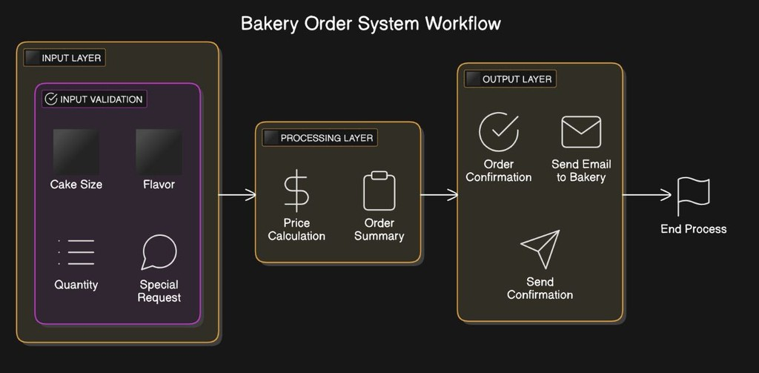
ARCHITECTURE DIAGRAM

Slide 9
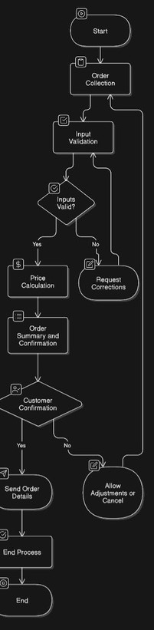
Flow diagram
8

Slide 10
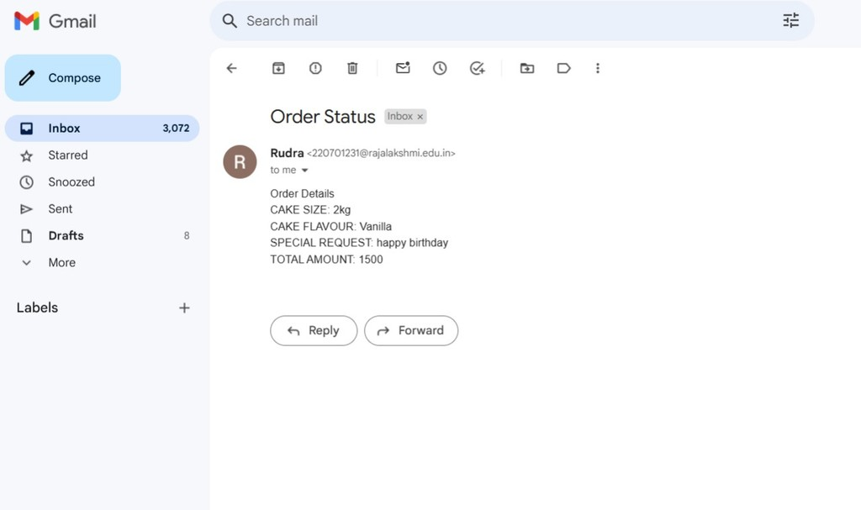
OUTPUT
9

Slide 11
Conclusion
The customized cake ordering bot provides an efficient and automated solution to streamline the cake ordering process, enhancing both customer and bakery experiences. By automating order collection, validation, and price calculation, the system reduces errors and ensures accurate order processing. The optional email notifications ensure prompt communication between the customer and the bakery.
Additionally, the user-friendly interface and real-time order confirmation improve overall customer satisfaction. The system also reduces staff workload, increasing operational efficiency.
With scalability in mind, the bot can easily be adapted to include new features or integrate with existing bakery systems.
Ultimately, this solution provides a seamless and consistent cake ordering experience.
10

Slide 12
Thank You

